Slide 1
Notable Convolution Networks

Slide 2
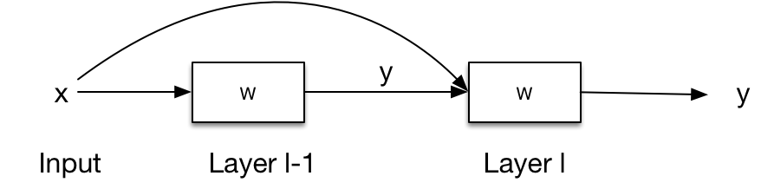

A Special Mention to… Residual Networks
Training accuracy of deep CNNs saturates, then degrades. The larger the network, the larger the error
We introduce “skip” connections and learn the residual function
F(x)=H(x)-x
This is easier to learn
https://arxiv.org/abs/1512.03385
$$y^{l−1}=f(W^{l−1}x+b^{l−1})+x$$

Slide 3
Microsoft ResNet 34

Slide 4
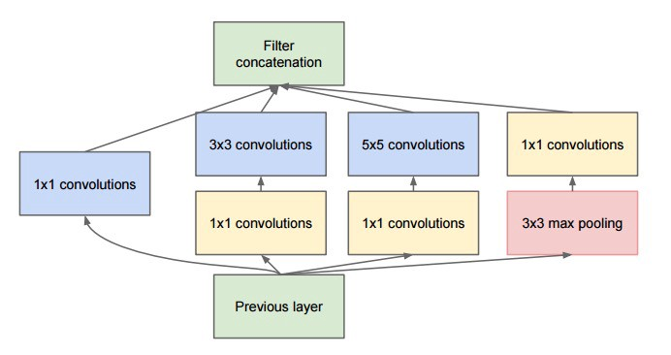
A Special Mention to… Inception Networks
Maximize the information flow by exploiting parallelism
Build “network in network” modules
https://arxiv.org/abs/1409.4842

Slide 5
Google Inception v4

Slide 6
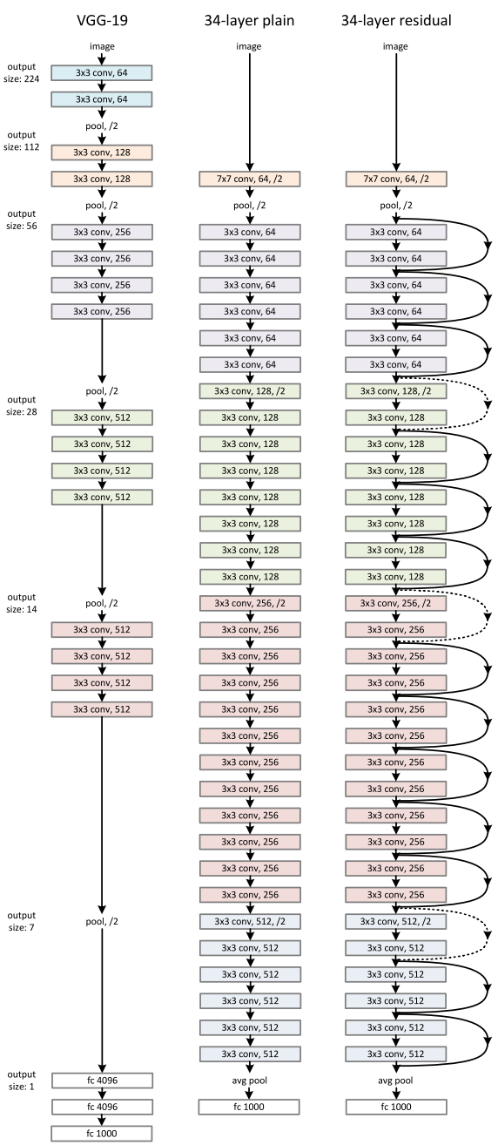
Transfer Learning
Convolutional Neural Networks
Good at detecting features in images
Transfer
Take pre-trained layers for feature detection
Insert and train new classifiers for own dataset
”Famous” networks:
VGG16/19 – Oxford University
ResNet18/34/50/152 - Microsoft
Inception v3/4 - Google

Slide 7

Feature Extraction
Get output of layer before the classifier
base_model.summary()
Layer (type) Output Shape Param # Connected to
==================================================================================================
input_9 (InputLayer) (None, 224, 224, 3) 0
__________________________________________________________________________________________________
conv1_pad (ZeroPadding2D) (None, 230, 230, 3) 0 input_9[0][0]
__________________________________________________________________________________________________
conv1 (Conv2D) (None, 112, 112, 64) 9472 conv1_pad[0][0]
__________________________________________________________________________________________________
bn_conv1 (BatchNormalization) (None, 112, 112, 64) 256 conv1[0][0]
__________________________________________________________________________________________________
activation_393 (Activation) (None, 112, 112, 64) 0 bn_conv1[0][0]
__________________________________________________________________________________________________
max_pooling2d_9 (MaxPooling2D) (None, 55, 55, 64) 0 activation_393[0][0]
<…a lot more layers…>
avg_pool (AveragePooling2D) (None, 1, 1, 2048) 0 activation_441[0][0]
__________________________________________________________________________________________________
flatten_9 (Flatten) (None, 2048) 0 avg_pool[0][0]
__________________________________________________________________________________________________
fc1000 (Dense) (None, 1000) 2049000 flatten_9[0][0]
==================================================================================================
Total params: 25,636,712
Trainable params: 25,583,592
Non-trainable params: 53,120
Cut here

Slide 8
Q&A

